Slide 1
Functions

Slide 2
Functions
In Python, functions are treated as objects, and so you can pass a function as an argument to another function.
Similarly, a function can return another function.
The def statement is used to define a function
Syntax:
def function-name(parameters):
statement(s)

Slide 3
Example:
The return statement is used for returning output from the function.
The statement is optionally followed by an expression.
func1.py
def sum(a, b):
return a + b
k=sum(10,20)
print ("Sum is", k)
Output:
Sum is 30

Slide 4
If a function doesn’t require any external data to process, it can be defined with no parameters.
func3.py
def quantity():
return 10
print (quantity())
q=quantity()
print (q)
Output:
10
10

Slide 5
Example:
func4.py
def conv(x):
if x==1:
return "one"
if x==2:
return "two"
if x==3:
return "three"
if x==4:
return "four"
n=int(input("Enter a number between 1 and 4: "))
print (n, "in words is", conv(n))
Output:
Enter a number between 1 and 4: 3
3 in words is three

Slide 6
Example:
passex2.py
def conv(x):
if x==0:
pass
if x==1:
return "one"
if x==2:
return "two"
if x==3:
return "three"
if x==4:
return "four"
print (conv(2))
print (conv(0))
Output:
two
None

Slide 7
Default Value Parameters
The parameters listed in the function definition may be mandatory or optional.
The mandatory parameters are those whose value has to be supplied in the form of arguments when calling the function.
The optional parameters are those whose value may or may not be passed when calling the function.
An optional parameter is defined with the following syntax:
identifier=expression

Slide 8
The following program demonstrates the use of a default parameter
func2.py
def sum(x, y=10):
return x+y
print (sum(10))
print (sum(5,8))
Output:
20
13

Slide 9
Keyword Arguments
If when calling a function you want to supply arguments for only a few of its parameters, you do so by naming the parameters when passing arguments.
A value passed to a parameter by referring to its name is known as a keyword argument.
The advantage of using this approach is that you don’t have to worry about the order of the arguments.

Slide 10
The following program demonstrates using keyword arguments when calling a function.
keywordarg.py
def volume(l, b=5, h=10):
print ('l is', l, 'and b is', b, 'and h is', h, 'and volume is', l*b*h)
volume(2, 4)
volume(3, h=6)
volume(h=7, l=2)
Output:
l is 2 and b is 4 and h is 10 and volume is 80
l is 3 and b is 5 and h is 6 and volume is 90
l is 2 and b is 5 and h is 7 and volume is 70

Slide 11
Global Variables
Global variables are not bound to any particular function and can be accessed within the body of the function, outside the body of the function, or by any other function.
The changes made to a global variable by any function will be visible by other functions.
If a function needs global variables, the first statement of the function must be this:
global identifiers
where identifiers is one or more identifiers separated by commas.

Slide 12
Example:
globalvar.py
def compute():
global x
print ("Value of x in compute function is", x)
x += 5
return None
def dispvalue():
global x
print ("Value of x in dispvalue function is", x)
x-=2
return None
x=0
compute()
dispvalue()
compute()
Output:
Value of x in compute function is 0
Value of x in dispvalue function is 5
Value of x in compute function is 3

Slide 13
Local Variables
The following program demonstrates the use of local variables:
localvar.py
def compute(x):
x += 5
print ("Value of x in function is", x)
return None
x=10
compute(x)
print ("Value of x is still", x)
Output:
Value of x in function is 15
Value of x is still 10

Slide 14
Applying Functions to Sequences
You have learned about the three types of sequences: strings, lists, and tuples.
The three methods in this section are filter(), map(), and reduce().
To implement these methods, you use functions
filter(function, sequence)

Slide 15
The filter() method returns a sequence consisting of those elements for which the included function returns true, those that satisfy the criteria given in the specified function.
If the included function is None, the method returns those elements of the sequence that are supposed to be returned when the function returns true.

Slide 16
The following program filters out the odd values and returns only the even values using the filter() method
def evenval(x):
return x % 2 ==0
evens=filter(evenval, range(1,11))
print(list(evens))
Output:
[2,4,6,8,10]

Slide 17
map(function, sequence)
The map method calls the included function for each of the elements in the sequence and returns a list of the returned values.

Slide 18
The following example displays the square values of the first 10 sequence numbers using the map() method:
def square(x):
return x*x
sqr=map(square, range(1, 11))
print(list(sqr))
Output:
[1, 4, 9, 16, 25, 36, 49, 64, 81, 100]

Slide 19
Let’s see an example of the map() method that converts the elements of the supplied sequence into integer values.
k=map( int, [ 5, 10.15, 20, 25.628, 7 ] )
print (list(k))
Output:
[5, 10, 20, 25, 7]

Slide 20
The reduce() method returns a single value that is produced by calling the function on the first two elements of the sequence.
The function then is called on the result of the function and the next element in the sequence, and so on.

Slide 21
The following reduce() method computes the sum of the numbers 1 through 10:
import functools
def add(x,y):
return x+y
r=functools.reduce(add, range(1, 11))
print(r)
Output:
55

Slide 22
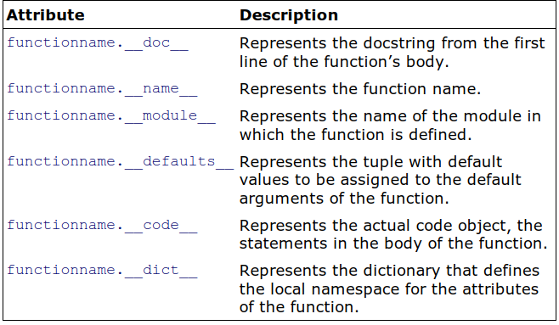
Function Attributes
A function object has a number of attributes that you can use to get more information about a function.
Also, you can change these attributes.

Slide 23
The following program demonstrates using function attributes to display specific information of the function, such as its version, author, docstring, and default arguments.
funcattrib.py
def sum(a, b=5):
"Adds the two numbers"
return a + b
sum.version= "1.0"
sum.author= "bintu"
k=sum(10,20)
print ('Sum is', k)
print('The documentation string is', sum.__doc__)
print('The function name is', sum.__name__)
print('The default values of the function are', sum.__defaults__)
print('The code object of the function is', sum.__code__)
print('The dictionary of the function is', sum.__dict__)
Output:
Sum is 30
The documentation string is Adds the two numbers
The function name is sum
The default values of the function are (5,)
The code object of the function is <code object sum at 0x00F11250, file "D:\python\
funcattrib.py", line 1>
The dictionary of the function is {'version': '1.0', 'author': 'bintu'}

